Slide 1
MapReduce Data processing framework for large scale systems
Department of Computer Science and Software Engineering
Concordia University
Presented by:
Shyam Kantesariya
Reza Morshed Behbahani

Slide 2
Motivation
Google had many parallel programs running individually implemented in C++
Goal was to develop a generic framework which is scalable and fault tolerant with high level abstraction
Programmer needs to code two methods to generate and aggregate <key,value> pairs

Slide 3
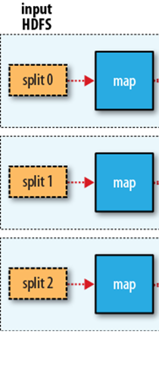
Execution phases of MapReduce program
Map:
In this step, each chunk is assigned to a mapper, a worker which is assigned to a map task, and the mapper applies Map() to each record in the chunk.
Follows data decomposing technique

Slide 4
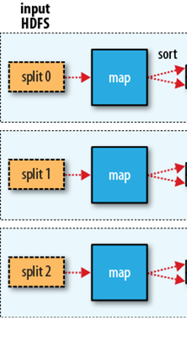
Execution phases of MapReduce program: Cont…
Sort:
The intermediate outputs produced by the mappers are sorted locally for grouping key-value pairs with the same key.

Slide 5
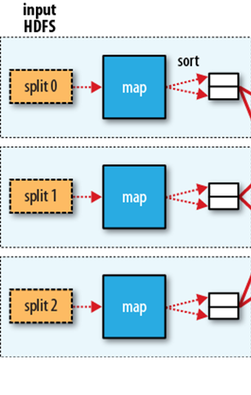
Execution phases of MapReduce program: Cont…
Partition:
After local sort, Combine() is applied to perform pre-aggregation on the grouped key-value pairs

Slide 6
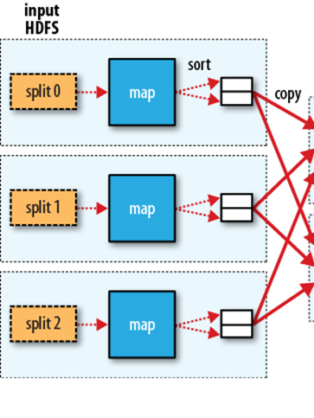
Execution phases of MapReduce program: Cont…
Shuffle:
The intermediate results will be shuffled and assigned to reducers.

Slide 7
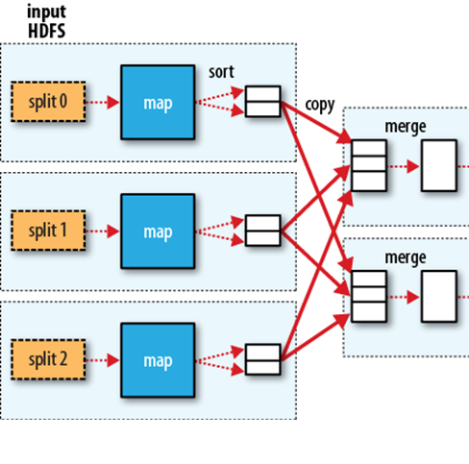
Execution phases of MapReduce program: Cont…
Merge:
A reducer reads the intermediate results and merge them by the intermediate keys. All values of the same key are grouped together.

Slide 8
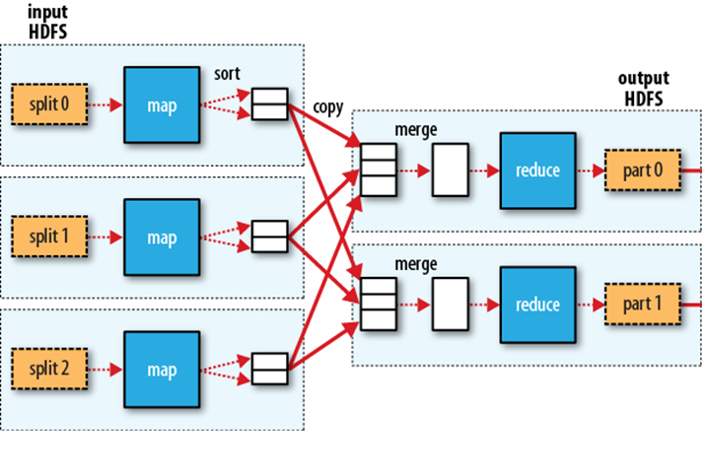
Execution phases of MapReduce program: Cont…
Reduce:
Each reducer applies Reduce function to the intermediate values for each encountered key.

Slide 9
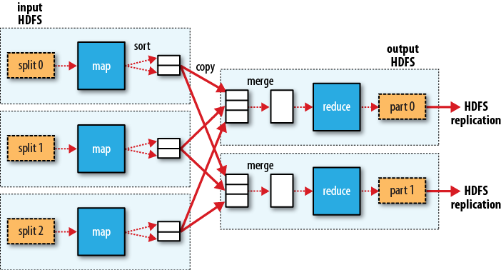
Execution phases of MapReduce program: Cont…

Slide 10
Performance issues and area of improvements
Output of map tasks will be written on local disc first and then transferred over the network during shuffle phase and that incurs I/O
Solutions:
Using relevant compression techniques while transferring data over network we can reduce the data size being transferred over network
Use of combiner class wherever applicable to reduces network I/O during shuffle phase
A small fraction of tasks running at the last
Solution:
Avoid any delay by configuring mappers/reducers as multiple of available task slots

Slide 11
Performance issues and area of improvements: Cont…
Overhead of environment setup for each task
Solutions:
Reuse the JVM if applicable
Frequent GC calls
Solution:
Reuse the object reference
for (String word : words) { output.collect(new Text(word), new IntWritable(1)); } | Text wordText = new Text(); IntWritable one = new IntWritable(1); for (String word : words) { wordText.set(word); output.collect(word, one); }

Slide 12
MapReduce vs Parallel Databases
MapReduce | Parallel Databases
2∼50 times slower than parallel DBMS | Not suited for solving extremely large data
Hadoop system is scalable but achieves very low efficiency per node | Parallel DBMS considers efficiency instead of fault tolerance
Open source but incurs cost for constructing and maintaining a cluster | Proprietary tools
Scheduling on runtime | Generates execution plan
Schema less | Schema Oriented
Complex to join multiple data sources | Easy to join multiple data sources

Slide 13
Advantages of Map-Reduce
Simple and easy to use
Programmer defines his job with only Map and Reduce functions, without specifying physical distribution of the job across nodes
Flexible
Unlike DBMS model, does not have any dependency on data model and schema
Independent of the storage
MapReduce can work with different storage layers
Fault tolerance
MapReduce is highly fault-tolerant
High scalability
The best advantage of using MapReduce is high scalability

Slide 14
Limitations of Map-Reduce
No high-level language
No high-level language like SQL in DBMS or any query optimization technique in MapReduce
Developers should code their Map and Reduce functions
No schema and index
MapReduce parse each items at reading input and transform them into data objects for data processing, which decrease performance

Slide 15
Limitations of Map-Reduce
A Single fixed dataflow
many complex algorithms are hard to implement with Map and Reduce.
Some algorithms that require multiple inputs are not supported because the dataflow of MapReduce read a single input and generate a single output
Low efficiency
MapReduce operations are not always optimized for I/O efficiency
Map and Reduce are blocking operations
MapReduce framework has a latency problem that comes from batch processing nature

Slide 16
Industry use cases
Finance
Risk modelling, to solve the question for banks to evaluate customers and markets better than legacy systems
Healthcare
intensive applications as in for curing diseases, reducing medical cost, predicting and managing epidemics and maintaining the quality of human life by keeping track of large scale health index and metrics
Telecom
telecom users are growing every day, practically it is not possible to manage and process usage and billing data in real time without transforming serial algorithms into parallel one
distributed computing for applications like predicting support calls, customer segmentation and clustering to name a few

Slide 17
Industry use cases
Retail
e-commerce is transforming the buying behavior of customers like never before
millions of transactions from their Brick-and-mortar outlets
parallel computing infrastructure to predict sales, real time feedback of promotional offers, identify loyalty customers, market basket analysis
Manufacturing
Real time sensor data processing for production infrastructure

Slide 18
Further Research
Storing map task output into in-memory for iterative processes
Communicating with cluster resource manager may optimize task scheduling
Stream oriented MapReduce flow
Optimizer to prepare an execution plan

Slide 19
Thank you
Question and Answer

